Slide 1
Merge Data Frames
By: rakesh kumar

Slide 2
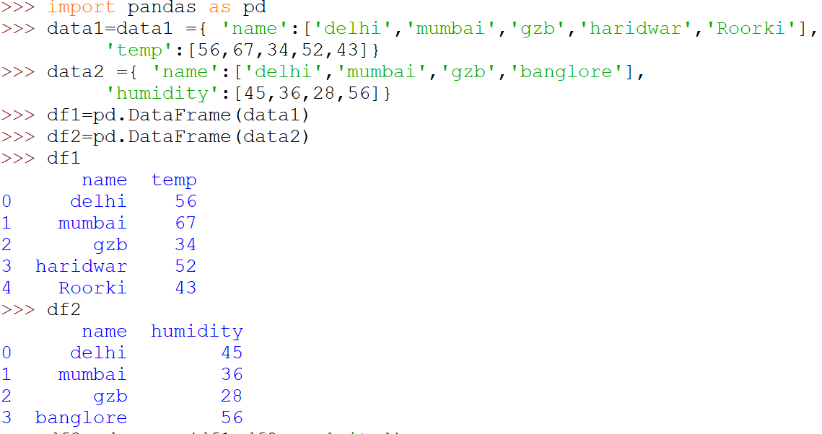
Merge - DataFrames

Slide 3
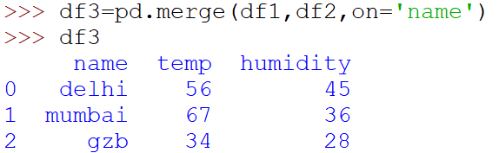
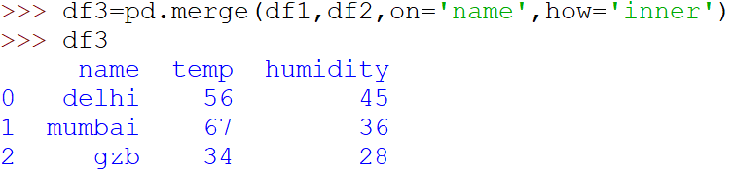
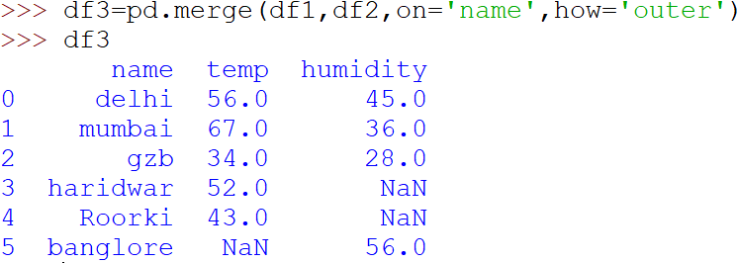
This is called inner join or intersection- where common values on both DataFrames appear

Slide 4
Outer Join

